Slide 1
Design Concepts
COMP6100001 - Software engineering
Session 05
Maulin Nasari, S.T., M.Kom.

Slide 2
Session 05 – Design Concepts
Learning objectives
At the end of this session, students will be expected to be able to:
Explain the role of design in SE
Describe design models and their evolution
Apply core design concepts (abstraction, modularity, etc.)
Analyze designs using cohesion & coupling
Differentiate analysis vs design classes
Interpret design modeling principles (traceability, simplicity, agility)

Slide 3
Session 05 – Design Concepts
Content outline
Design Within the Context of Software Engineering
The Design Process
Design Concepts
The Design Model

Slide 4
Design Within the Context of Software Engineering
Software design is the technical core of software engineering
Begins after requirements analysis and modeling
Final activity in the modeling phase
Sets the foundation for:
      Construction (coding & testing)
      Maintenance
Design translates what is needed into how it will be built.

Slide 5
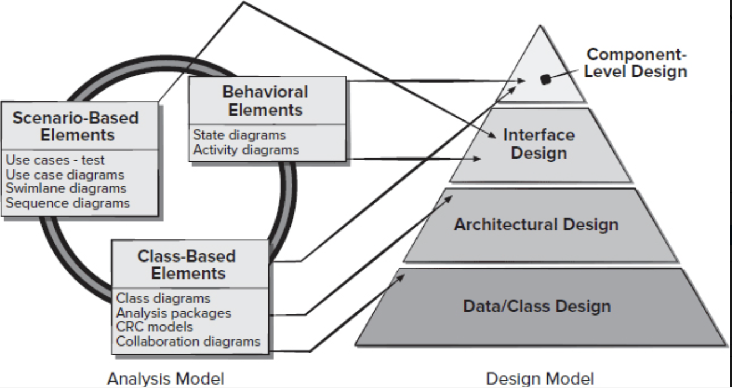
Design Within the Context of Software Engineering
Requirements models feed four design models:
    Data / Class Design
    Architectural Design
    Interface Design
    Component-Level Design
Design decisions directly affect:
Software quality
Stability
Maintainability
Design is where software quality is created. Poor design leads to fragile, hard-to-maintain systems.

Slide 6
The Design Process
What Defines a Good Software Design?
A good design implements all explicit and implicit requirements
A good design is clear and understandable for developers, testers, and maintainers
A good design provides a complete view of:
      Data
      Function
      Behavior
Design quality is not about elegance alone. It’s about correctness, clarity, and completeness.

Slide 7
The Design Process
Software Design Quality Guidelines
Architecture
Uses recognizable styles or patterns
Supports incremental and testable implementation
Modularity
Logically partitioned components
Independent functional units
Clarity & Structure
Separate views for data, architecture, interfaces, and components
Clear and simple interfaces
Process & Communication
Derived from requirements analysis
Represented using clear and consistent notation
Quality design is intentional, achieved through principles, methods, and review.

Slide 8
Design Concepts
Fundamental Design Concepts
Design concepts provide a foundation for all software design
Help designers:
Partition systems into components
Separate what from how
Evaluate technical design quality
Focus on building the right software, not just working software
Design concepts guide thinking before tools or code are involved.

Slide 9
Design Concepts
Abstraction
Abstraction describes a solution at multiple levels
High-level: problem domain (e.g., user story)
Mid-level: system behavior (e.g., use case)
Low-level: implementable detail (e.g., pseudocode)
Two types of abstraction:
Procedural abstraction: what a function does
Data abstraction: what data represents

Slide 10
Design Concepts
Architecture
Defines the overall structure of the system
Describes:
Major components
Interactions between components
Organization of data
Addresses both:
Structural properties (components & connections)
Extra-functional properties (performance, security, reliability)
Architecture provides the framework for all detailed design decisions.

Slide 11
Design Concepts
Patterns
A design pattern is a proven solution to a recurring design problem
Captures:
Context
Problem
Solution
Constraints (“forces”)
Helps designers:
Reuse design knowledge
Reduce design time
Improve consistency
Patterns encode experience — not code.

Slide 12
Design Concepts
Separation of Concerns
Complex problems are easier when divided into smaller concerns
Each concern:
Can be designed independently
Reduces overall complexity
Leads to:
Modularity
Functional independence
Refinement
Divide-and-conquer is the basis of scalable software design.

Slide 13
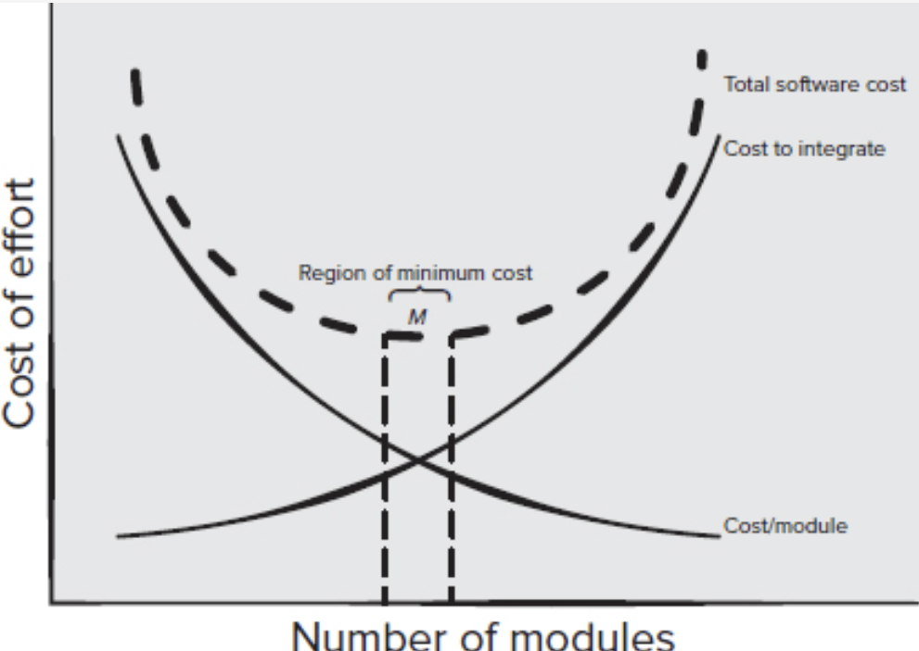
Design Concepts
Modularity
Modularity divides software into separate, manageable modules
Makes software:
Easier to understand
Easier to build and test
Easier to change and maintain
Too few modules → complex, hard to understand (monolithic)
Too many modules → high integration cost
There exists an optimal range of modularity (M) where total cost is minimized
Modularity reduces complexity — but excessive modularization increases integration cost.

Slide 14
Design Concepts
Information Hiding
Key Idea
Modules should hide internal data and algorithms
Only expose what other modules need to know
What is Hidden?
Internal data structures
Algorithm details
Local design decisions
Why It Matters
Reduces ripple effects when changes occur
Prevents accidental misuse of internal logic
Makes maintenance and evolution safer
Change inside a module should not force changes outside it.

Slide 15
Design Concepts
Functional Independence (Cohesion & Coupling)
Key Idea
Each module should do one focused job
Interaction with other modules should be minimal and simple
Two Quality Indicators
High Cohesion → module does one well-defined task
Low Coupling → minimal dependency on other modules
Why It Matters
Easier development and team collaboration
Easier testing and debugging
Less error propagation
Better reusability
Modules that do many unrelated things (“schizophrenic modules”)

Slide 16
Design Concepts
Stepwise Refinement
Key Idea
Design software top-down, from abstract to detailed
Gradually refine until implementable logic is reached
How It Works
Start with a high-level description of function
Break it into smaller steps
Repeat until code-level detail is clear
Relationship to Abstraction
Abstraction hides detail
Refinement reveals detail progressively
Why It Matters
Controls complexity
Improves clarity of design decisions
Produces a traceable design flow

Slide 17
Design Concepts
Refactoring
Key Idea
Improve internal design without changing behavior
What Refactoring Fixes
Low cohesion
Redundant or unused elements
Poor structure or inefficient logic
Why It Matters
Keeps design clean as software evolves
Reduces technical debt
Makes future changes easier and safer
Important Note
Refactoring must be supported by testing
Behavior must remain unchanged
Refactoring improves design quality, not functionality.

Slide 18
Design Concepts
Design Classes
From Analysis to Design
Analysis classes → describe problem-domain concepts (what users see)
Design classes → refine analysis classes with technical detail for implementation
As architecture emerges, abstraction is reduced and classes become code-ready
Purpose of Design Classes
Define attributes + methods needed for implementation
Provide a blueprint for developers
Support the overall software architecture

Slide 19
Design Concepts
Design Classes
Characteristics of a Well-Formed Design Class
1. Complete & Sufficient
Contains all attributes and methods reasonably expected
No missing responsibilities
No unnecessary functionality
2. Primitive
Each method does one clear service
No duplicate ways to perform the same action
3. High Cohesion
Methods and attributes focus on a single responsibility
Class does one thing well
4. Low Coupling
Minimal dependency on other classes
Follows the Law of Demeter: talk only to “neighbor” classes

Slide 20
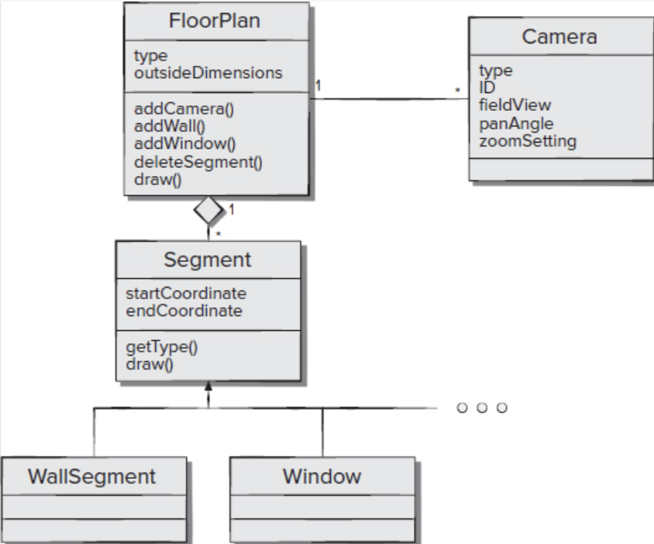
Design Concepts
Design Classes
Shows how an analysis concept becomes a design-ready class
Demonstrates:
Encapsulation of data + behavior
Composition (FloorPlan → Segment)
Controlled collaboration with Camera

Slide 21
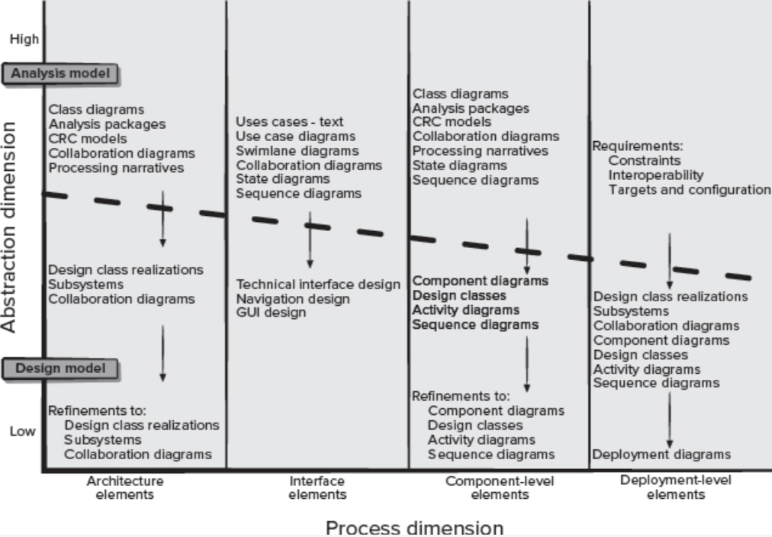
The Design Model
From Analysis to Implementation
What this diagram shows
The transition from analysis model → design model
How software design progressively reduces abstraction
How different design views evolve in parallel
Design is not a single step, but a systematic refinement of analysis artifacts into implementable structures across architecture, interface, components, and deployment.

Slide 22
The Design Model
Two Key Dimensions
1. Abstraction Dimension (Vertical)
Top (High abstraction)
Focus: what the system should do
Artifacts: use cases, analysis class diagrams, behavioral models
Bottom (Low abstraction)
Focus: how the system will be built
Artifacts: design classes, components, deployment diagrams
Design gradually moves from conceptual to technical detail
2. Process Dimension (Horizontal)
Design is refined across four complementary views:
Architecture Elements
Subsystems and major structural decisions
Defines the system’s backbone
Interface Elements
User interface and external interfaces
Navigation, interaction, technical interfaces
Component-Level Elements
Internal logic and component behavior
Design classes, activity and sequence diagrams
Deployment-Level Elements
Physical realization of the system
Nodes, environments, and deployment constraints

Slide 23
The Design Model
Design Modeling Principles
Principle 1. Design should be traceable to the requirements model.
Principle 2. Always consider the architecture of the system to be built.
Principle 3. Design of data is as important as design of processing functions.
Principle 4. Interfaces (both internal and external) must be designed with care.
Principle 5. User interface design should be tuned to the needs of the end user.
Principle 6. Component-level design should be functionally independent.
Principle 7. Components should be loosely coupled to one another and to the external environment.
Principle 8. Design representations (models) should be easily understandable.
Principle 9. The design should be developed iteratively.
Principle 10. Creation of a design model does not preclude an agile approach.

Slide 24
References
Roger Pressman and Bruce Maxim. (2020). Software Engineering: A Practitioner's Approach. 9th. McGraw Hill. New York. ISBN: 978-1259872976.

